Slide 1
How to use this slide template:
We have marked in bright red all the parts of the template that need to be updated with your information.
Consult the Lesson Plan for detailed information on the content.
We include places to put Slido polls; remove these slides if you’re not using them.
Update the schedule (slides 6, 21, 35, 60) if you are adding/removing content.
If you are not doing breakout sessions after the presentation, remove the last slide (slide 61) before Recap & Closing.
Feel free to move the acknowledgments slide to the end, but please don’t remove it ☺

Slide 2
INSERT Slido Poll Question: What is the biggest challenge you have when creating a figure?
WELCOME TO:
A slide template for: Explaining scientific findings through figures in publications, presentations, and posters
By Nataliya Rokhmanova & Andrew Schulz
Notes:
Slido poll questions are accessible from here: https://auth.slido.com/eu1/api/latest/the-auth/user/lifecycle-process/shareable-link/init?token=1411c175e7054b41562dcdc408a8c74d0be92151276530dd5f71ec1e5281cfb2

Slide 3
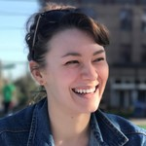
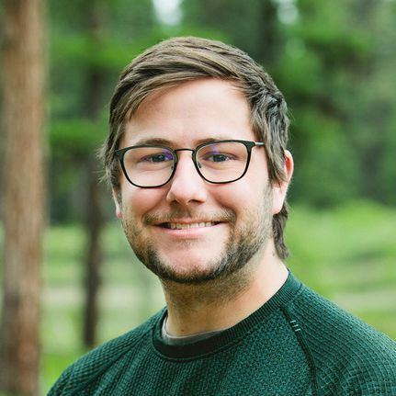
Who created these materials?
MPI – IS / CARNEGIE MELLON UNIVERSITY
MPI - IS
Nataliya Rokhmanova
Dr. Andrew Schulz
PhD Candidate
Postdoctoral Researcher
IMPRS-IS Associated Scientist
Notes:
Please do not remove this slide if presenting these slides, but feel free to move it to the end of the presentation. This is the acknowledgment slide for these workshop slides.

Slide 4
Who are we?
UNIVERSITY HERE
UNIVERSITY HERE
Your Name Here
Your Name Here
Title Here
Title Here
Notes:
Insert presenters of the workshop here

Slide 5
Workshop Outcomes
TAKE-HOME
LEARNING
Participants will learn how to critically review their figures using:
The Figure Spectrum
The Figure Rubric
Participants will learn about open tools available, such as:
Inkscape
Link Sheet
Participants will understand key differences between:
Figures for publications
… presentations (e.g. TAC meetings)
… and posters

Slide 6
Schedule for Today
09:55 – 10:10 - Intro of presenters & purpose of workshop
10:10 – 10:28 - Figure Activity, Spectrum of Figures shown
10:28 – 10:30 - Q&A Break
10:30 – 10:43 - Rubric introduction
10:43 – 10:50 - Q&A Break
10:50 – 11:05 - Posters, presentations, publications, give link sheet out
11:05 – 11:20 - Q&A break & transition to breakouts
11:20 – 11:50 - Breakouts
11:50 – 11:55 - Recap, GitHub discussion
11:55 – 12:00 - End
Notes:
Paste the exact schedule from the Syllabus sheet

Slide 7
INSERT Slido Word Cloud Question: What words are often associated with good figures?
Notes:
Slido poll questions are accessible from here: https://auth.slido.com/eu1/api/latest/the-auth/user/lifecycle-process/shareable-link/init?token=1411c175e7054b41562dcdc408a8c74d0be92151276530dd5f71ec1e5281cfb2

Slide 8
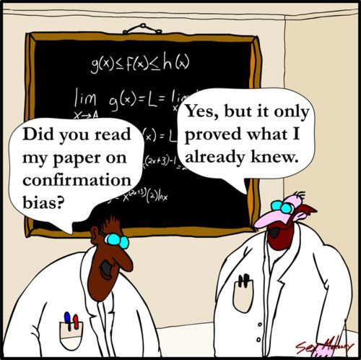
Why bother making a nice figure?

Slide 9
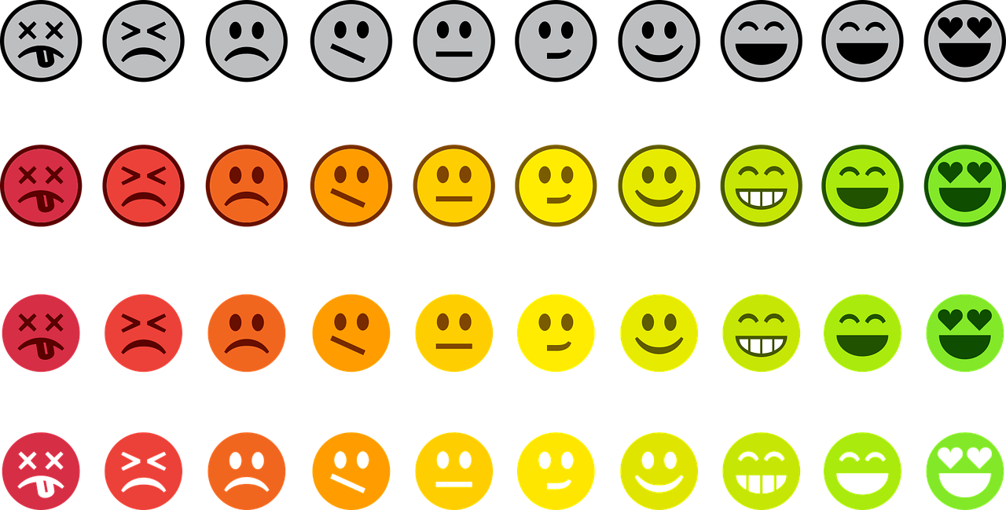
Your audience, forever*
JOURNAL EDITOR
1ST YEAR
HIRING COMMITTEE
Doing 5 things at once. Deciding whether to send your paper out for review.
Wants to replicate your work. Doesn’t understand the field’s conventions.
Sleep-deprived. Deciding whether to offer you an interview.
REPORTER
REVIEWER 2
Told to write an article about advances in your field. Still learning.
Undercaffeinated. Expert in your field. Wants to find flaws in your paper.
*except in cases of paper retraction, scientific obsolescence, and/or heat death of the universe

Slide 10
A (typical) timeline:
Referring back to your findings in:
Posters and talks
Committee meetings or thesis defense
Meetings with potential collaborators
Job talks
Generating hypotheses and research questions; collecting data; processing and analysis; writing and revising
Making sure your figures match paper requirements
0 – 2 YEARS
1 WEEK
THE REST OF TIME
Why not spend more time here?

Slide 11
What is the main point of this figure?
Figure Spectrum visualizations made using data from Kaggle data set: Eurovision Song Contest Scores 1975-2019

Slide 12
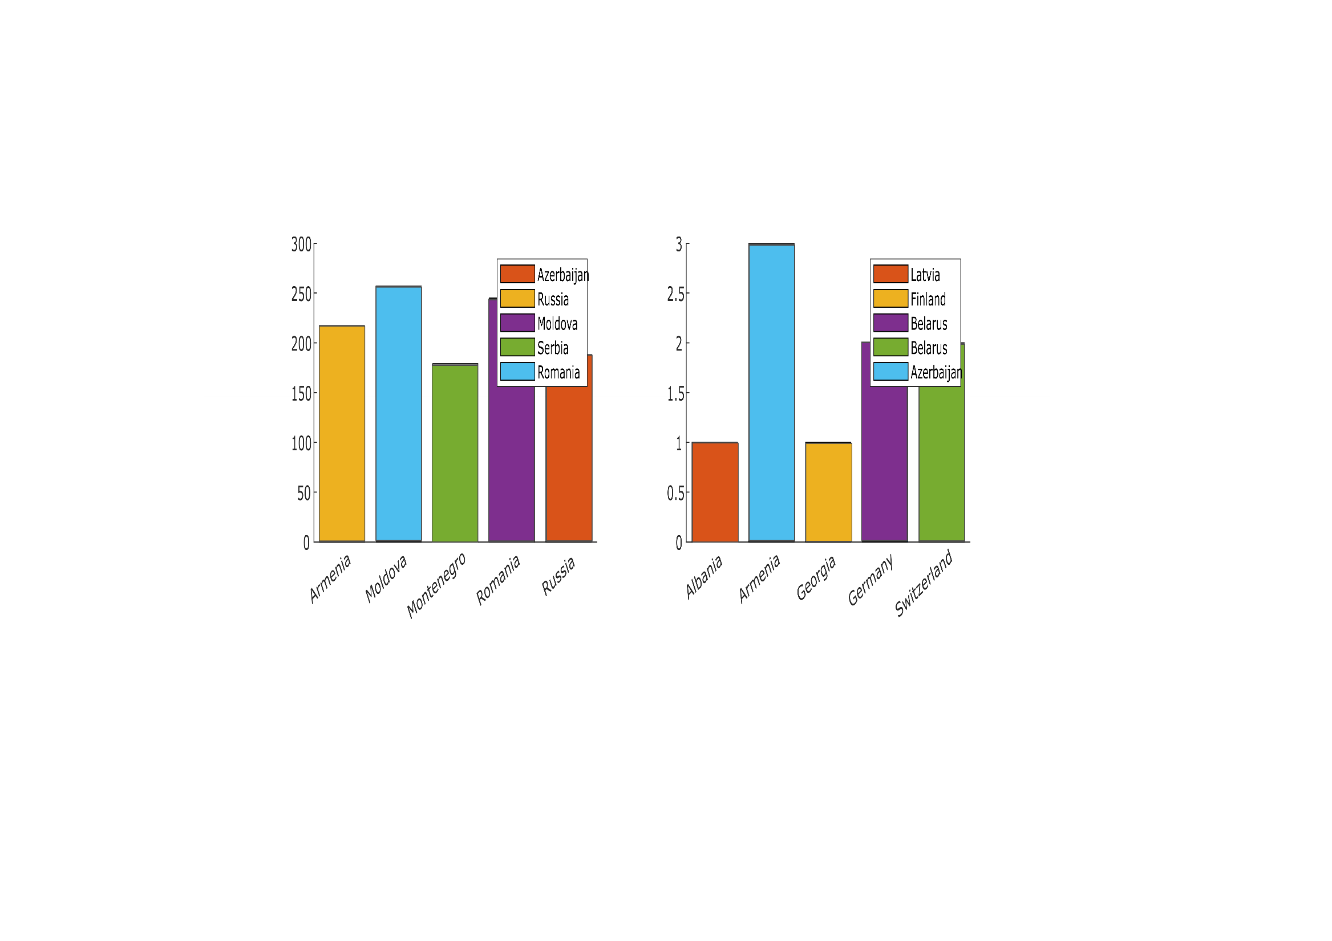
What is the main point of this figure?

Slide 13
INSERT Slido Poll Question: What is the main point of this figure?
Notes:
Slido poll questions are accessible from here: https://auth.slido.com/eu1/api/latest/the-auth/user/lifecycle-process/shareable-link/init?token=1411c175e7054b41562dcdc408a8c74d0be92151276530dd5f71ec1e5281cfb2

Slide 14
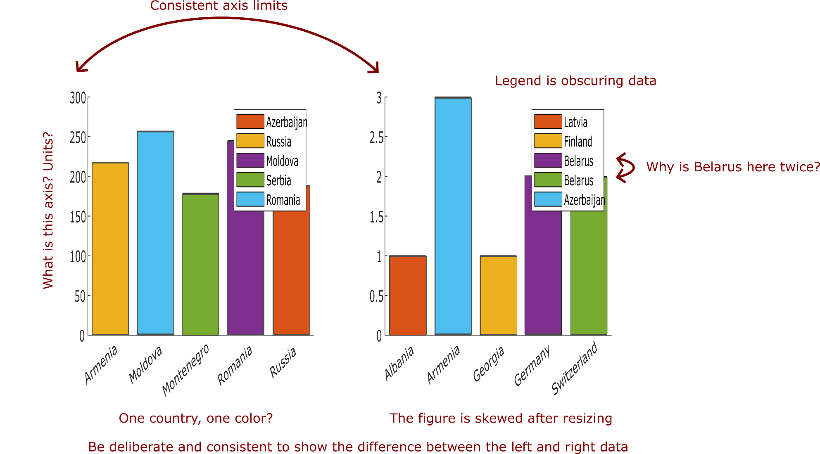
Fixing up the basics:

Slide 15
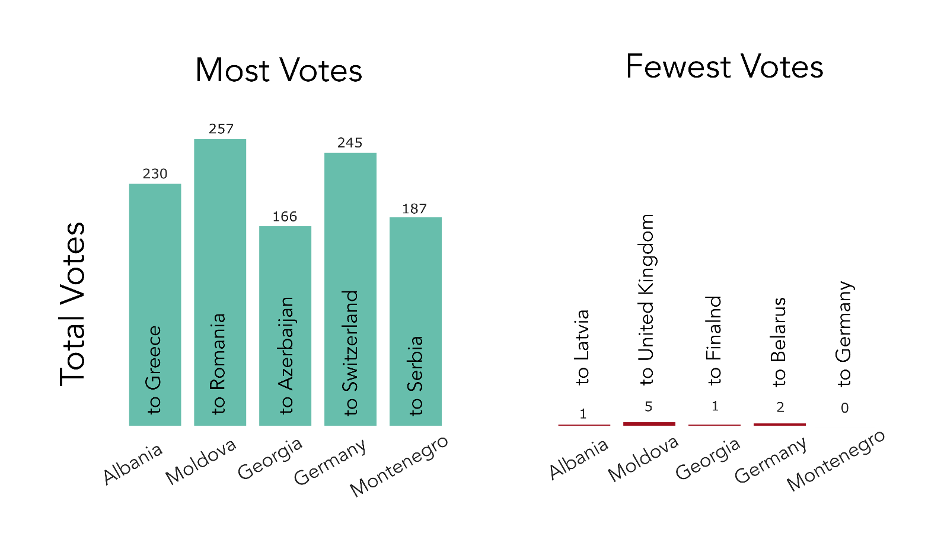
What changed? What is missing?

Slide 16
Content vs. format

Slide 17
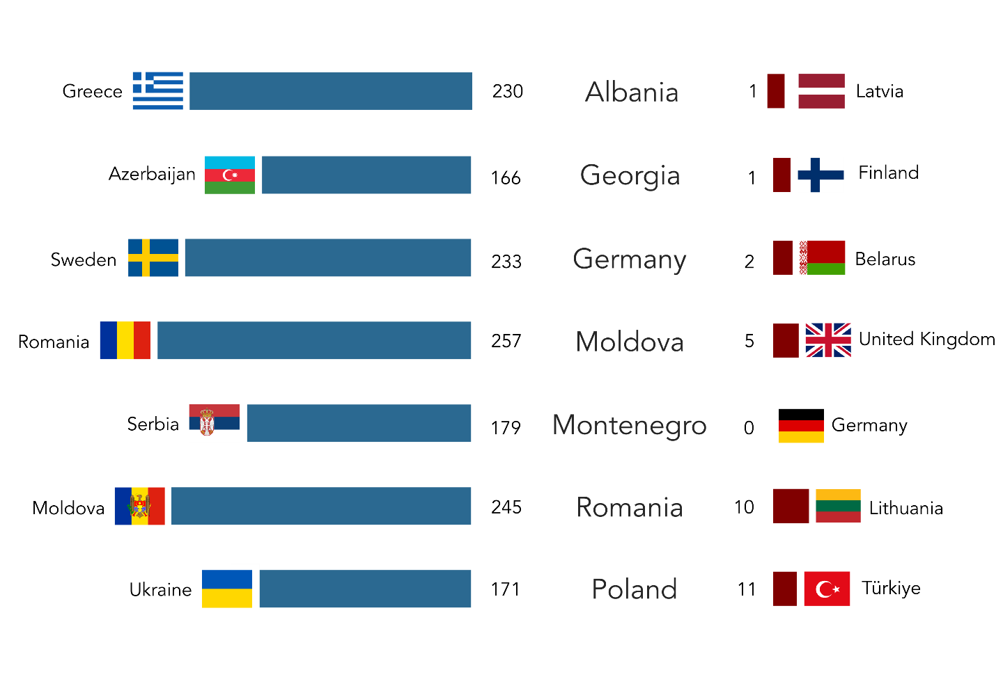
What changed? What is missing?

Slide 18
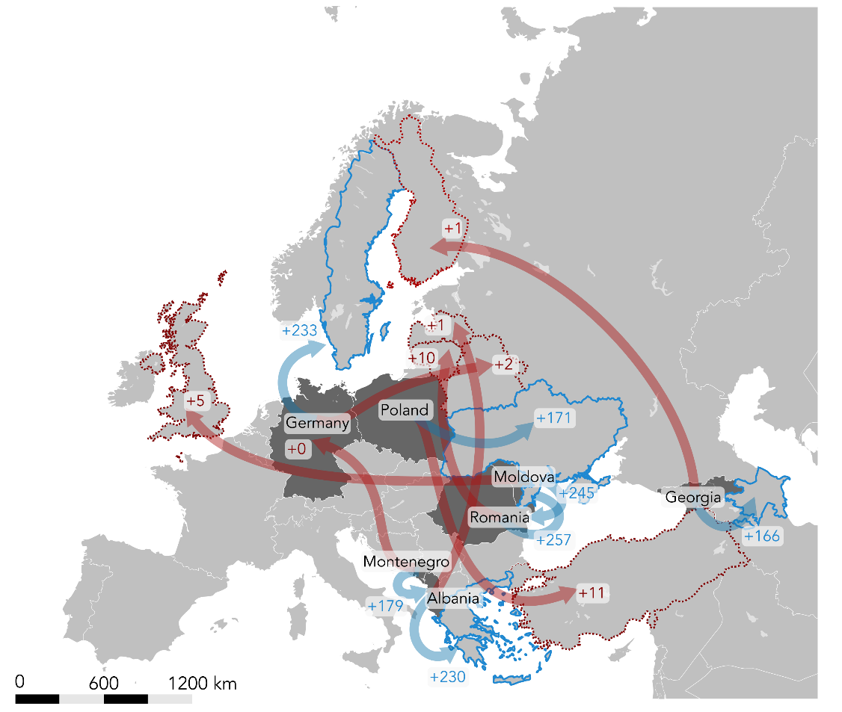
What changed? What is missing?

Slide 19
How do the needs of a figure change…
FOR A PAPER,
POSTER, OR
PRESENTATION?

Slide 20
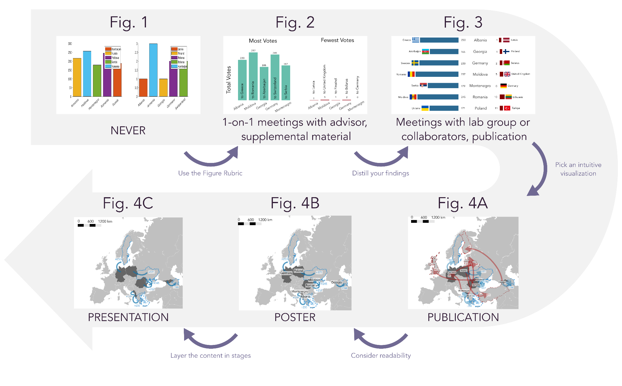
THE FIGURE SPECTRUM
Handout:

Slide 21
Schedule for Today
09:55 – 10:10 - Intro of presenters & purpose of workshop
10:10 – 10:28 - Figure Activity, Spectrum of Figures shown
10:28 – 10:30 - Q&A Break
10:30 – 10:43 - Rubric introduction
10:43 – 10:50 - Q&A Break
10:50 – 11:05 - Posters, presentations, publications, give link sheet out
11:05 – 11:20 - Q&A break & transition to breakouts
11:20 – 11:50 - Breakouts
11:50 – 11:55 - Recap, GitHub discussion
11:55 – 12:00 - End
Notes:
Paste the exact schedule from the Syllabus sheet

Slide 22



We will become figure surgeons today:
ERROR FLAGGING:
DOMAIN KNOWLEDGE:
TECHNICAL SKILLS:
Realizing something doesn’t look right
Finding possible solutions
Being able to fix it

Slide 23
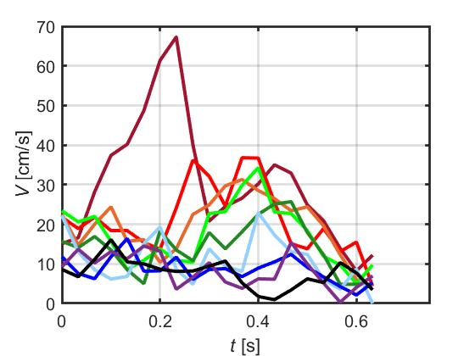
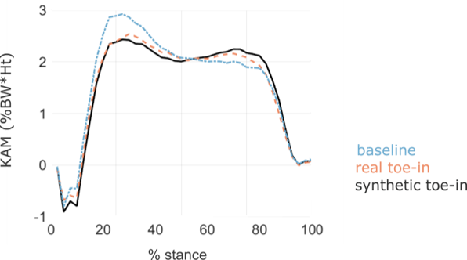
Surgical training takes time and repetition
Notes:
This slide is an old visualization of data analysis performed by N.R. and A.S.
Data are later published in:
Rokhmanova N, Kuchenbecker KJ, Shull PB, Ferber R, Halilaj E (2022) Predicting knee adduction moment response to gait retraining with minimal clinical data. PLOS Computational Biology 18(5): e1009500. https://doi.org/10.1371/journal.pcbi.1009500
A. K. Schulz et al., “Skin wrinkles and folds enable asymmetric stretch in the elephant trunk,” Proceedings of the National Academy of Sciences, vol. 119, no. 31, p. e2122563119, Aug. 2022, doi: 10.1073/pnas.2122563119.

Slide 24
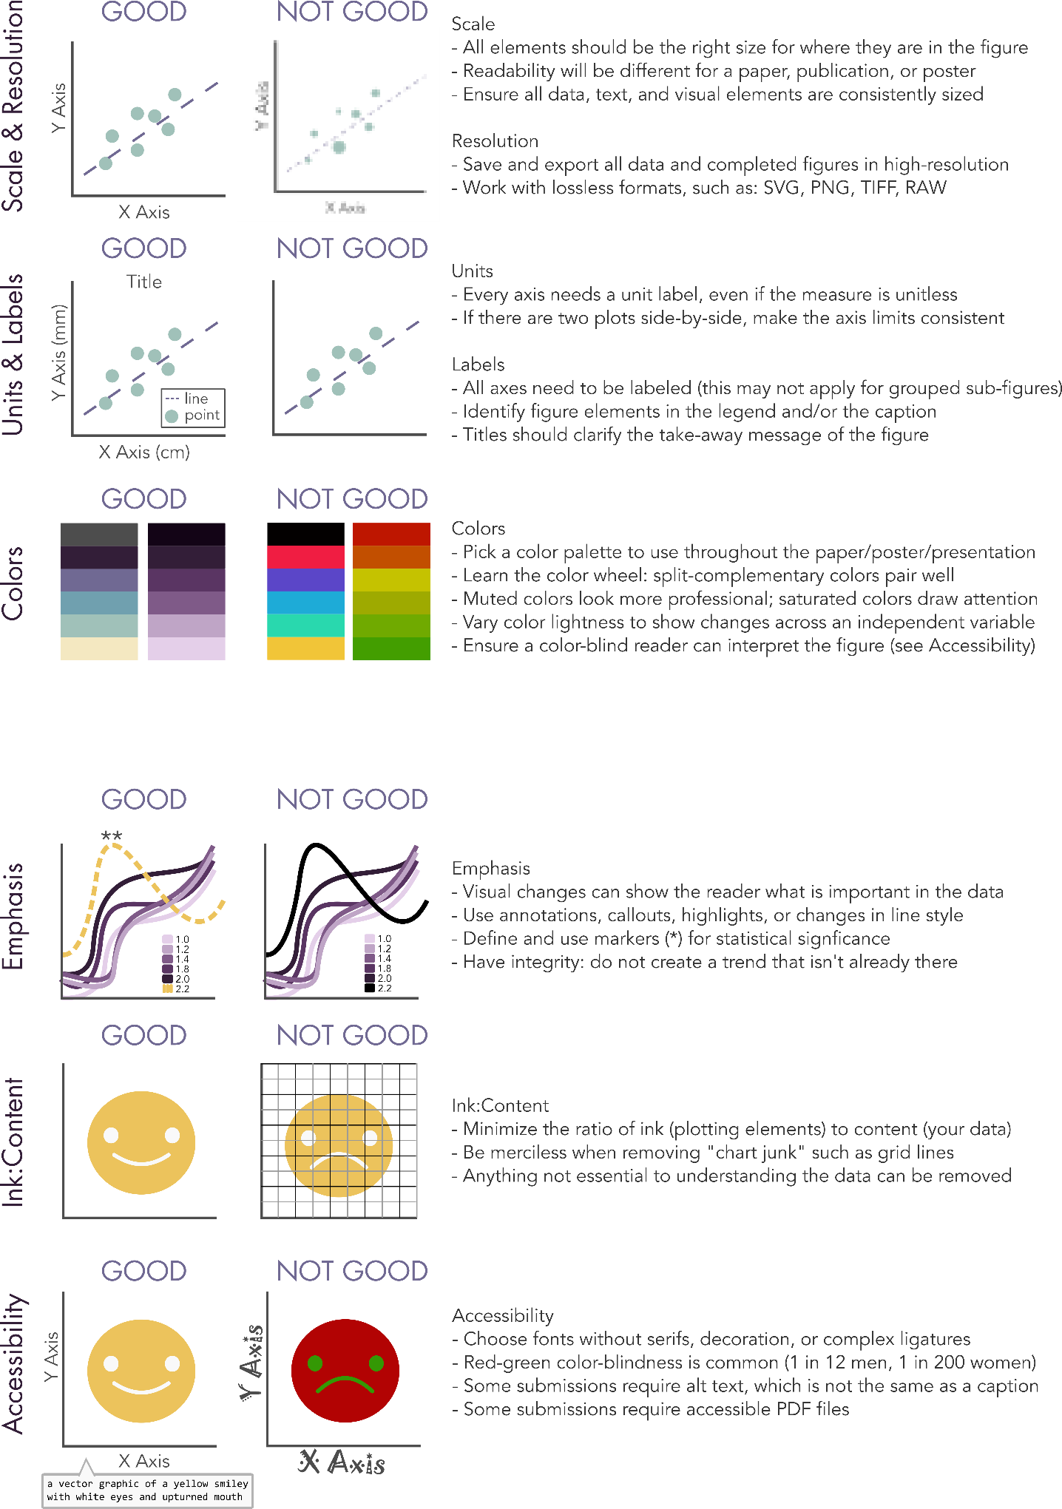
THE FIGURE RUBRIC
Handout:

Slide 25
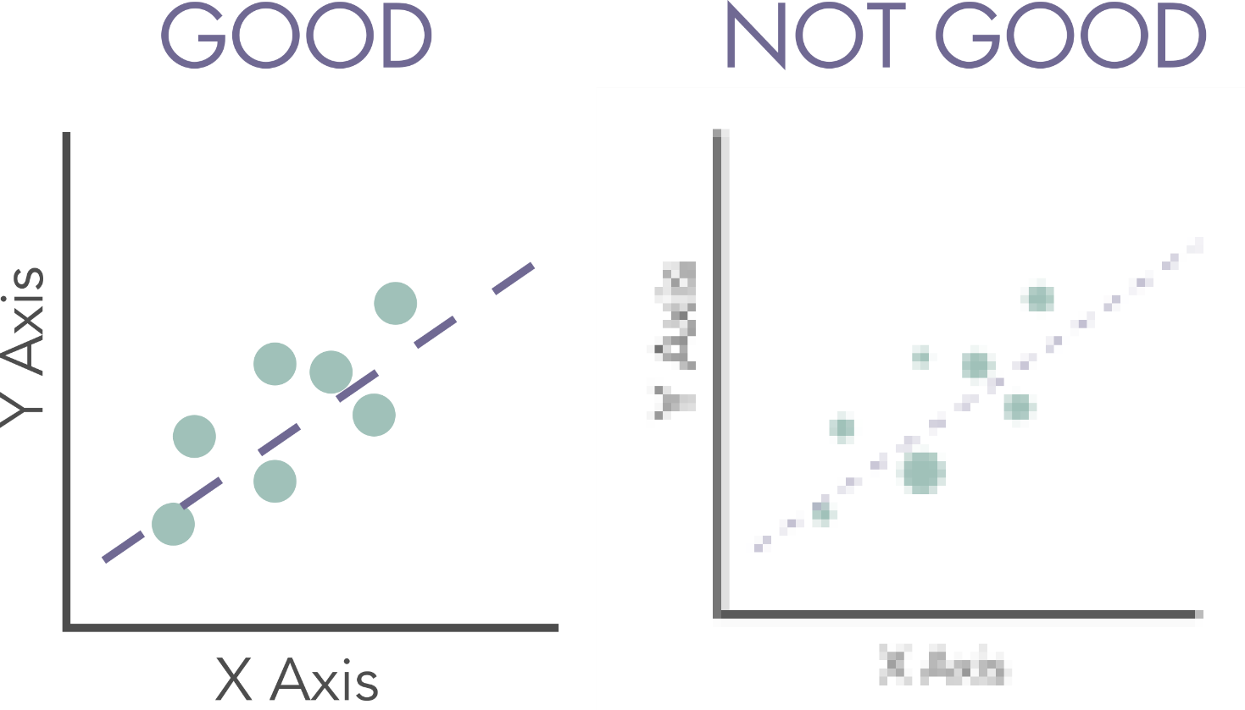
Low-hanging fruit: is your figure readable?
SCALE & RESOLUTION
Work in lossless formats; version control matters here, too

Slide 26
“Readability” depends on context
SCALE & RESOLUTION
PAPERS
POSTERS
PRESENTATIONS
Figure font should not be much smaller than body font size
Readable at all distances/levels of engagement
Usually need to increase size
Save your figures in an editable format!

Slide 27
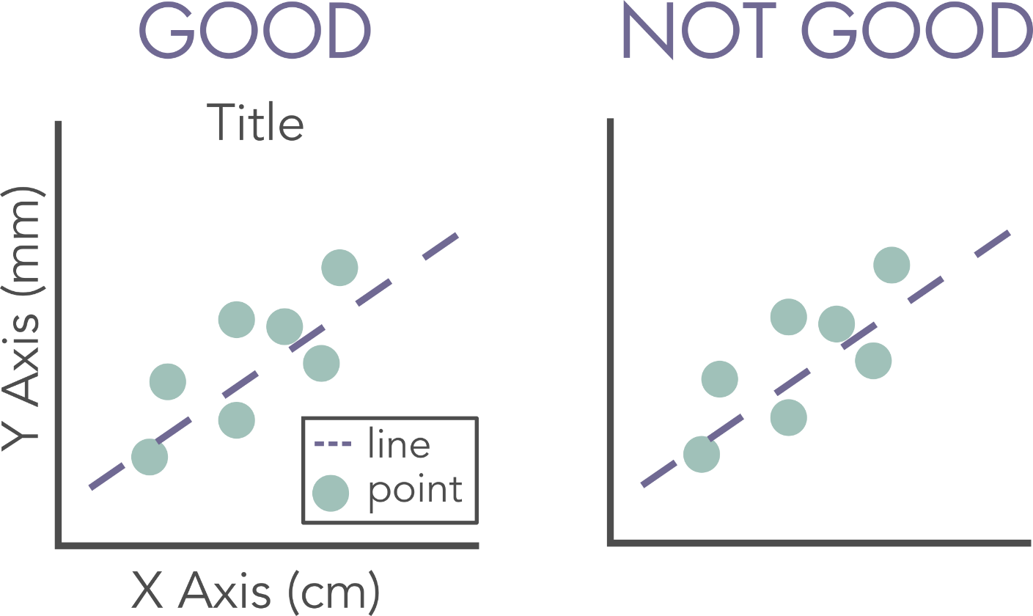
Low hanging fruit: is your figure interpretable?
UNITS & LABELS
What’s obvious to you might not be obvious to everyone

Slide 28

“Color is a power which directly influences the soul”
COLORS
- Wassily Kandinsky

Slide 29
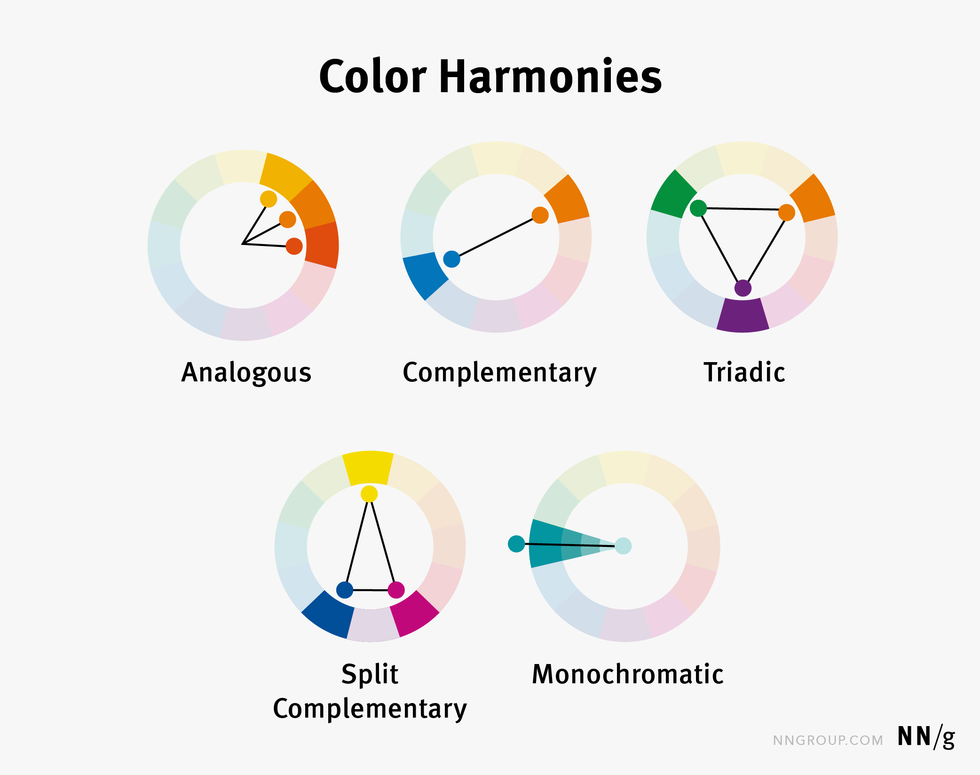
You CAN and SHOULD learn color theory
COLORS
Gordon, Kelley (June 6, 2021), Using Color to Enhance your Design, Nielsen Normal group

Slide 30
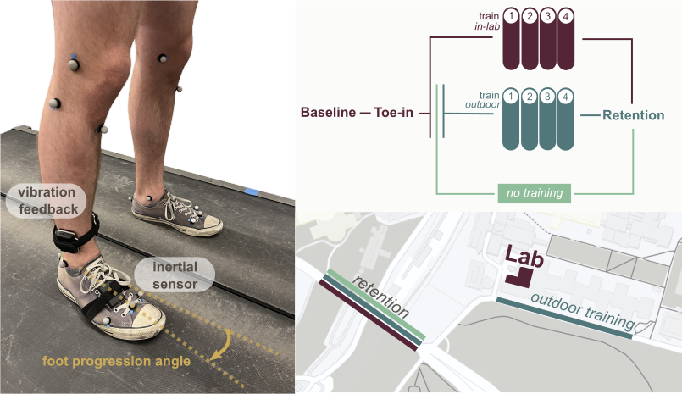
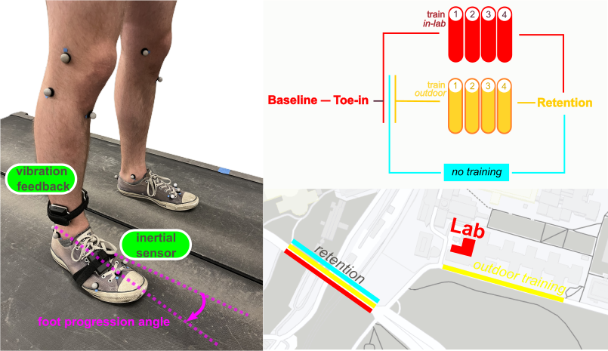
Pick your paper palette
COLORS
Unpleasant to look at
Much better
Rokhmanova, N, Pearl, O, Kuchenbecker, KJ, Halilaj, E. “IMU-Based Kinematics Estimation Accuracy Affects Gait Retraining using Vibrotactile Cues” TNSRE (under review)

Slide 31
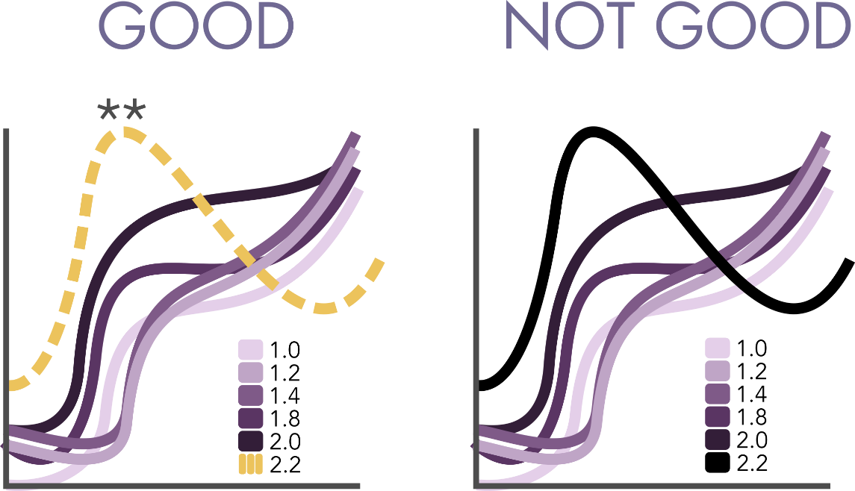
Be nice: help your viewer understand
EMPHASIS
Be ethical: don’t highlight trends where there are none

Slide 32

Minimize “chart junk” and maximize content
INK:CONTENT
Ruthlessly eliminate anything that does not serve you

Slide 33
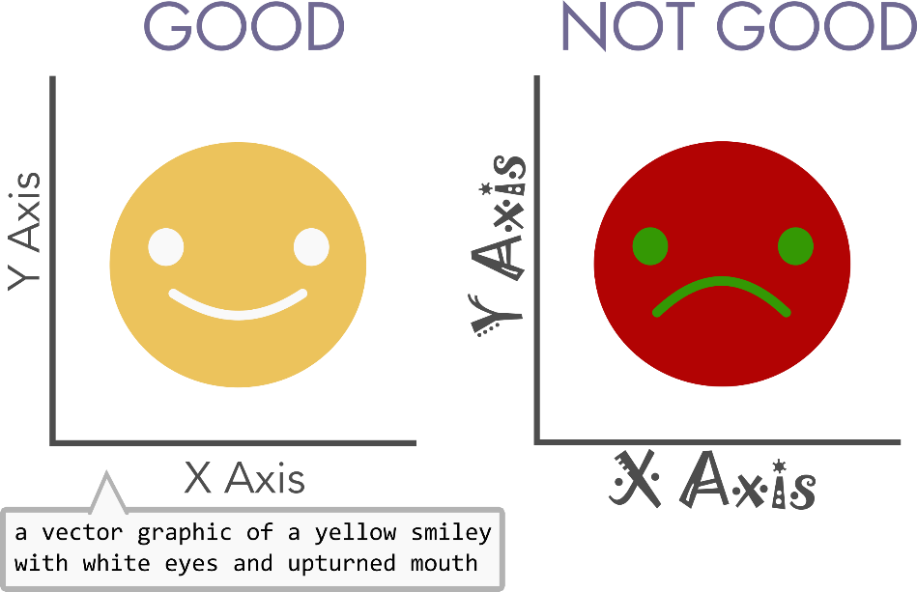
Increasing accessibility, always evolving
ACCESSIBILITY
Examples include alt text, color choices, readability…

Slide 34

All tools to implement this is on your link sheet

Slide 35
Schedule for Today
09:55 – 10:10 - Intro of presenters & purpose of workshop
10:10 – 10:28 - Figure Activity, Spectrum of Figures shown
10:28 – 10:30 - Q&A Break
10:30 – 10:43 - Rubric introduction
10:43 – 10:50 - Q&A Break
10:50 – 11:05 - Posters, presentations, publications, give link sheet out
11:05 – 11:20 - Q&A break & transition to breakouts
11:20 – 11:50 - Breakouts
11:50 – 11:55 - Recap, GitHub discussion
11:55 – 12:00 - End

Slide 36

Questions?
Illustration from Undraw.co

Slide 37
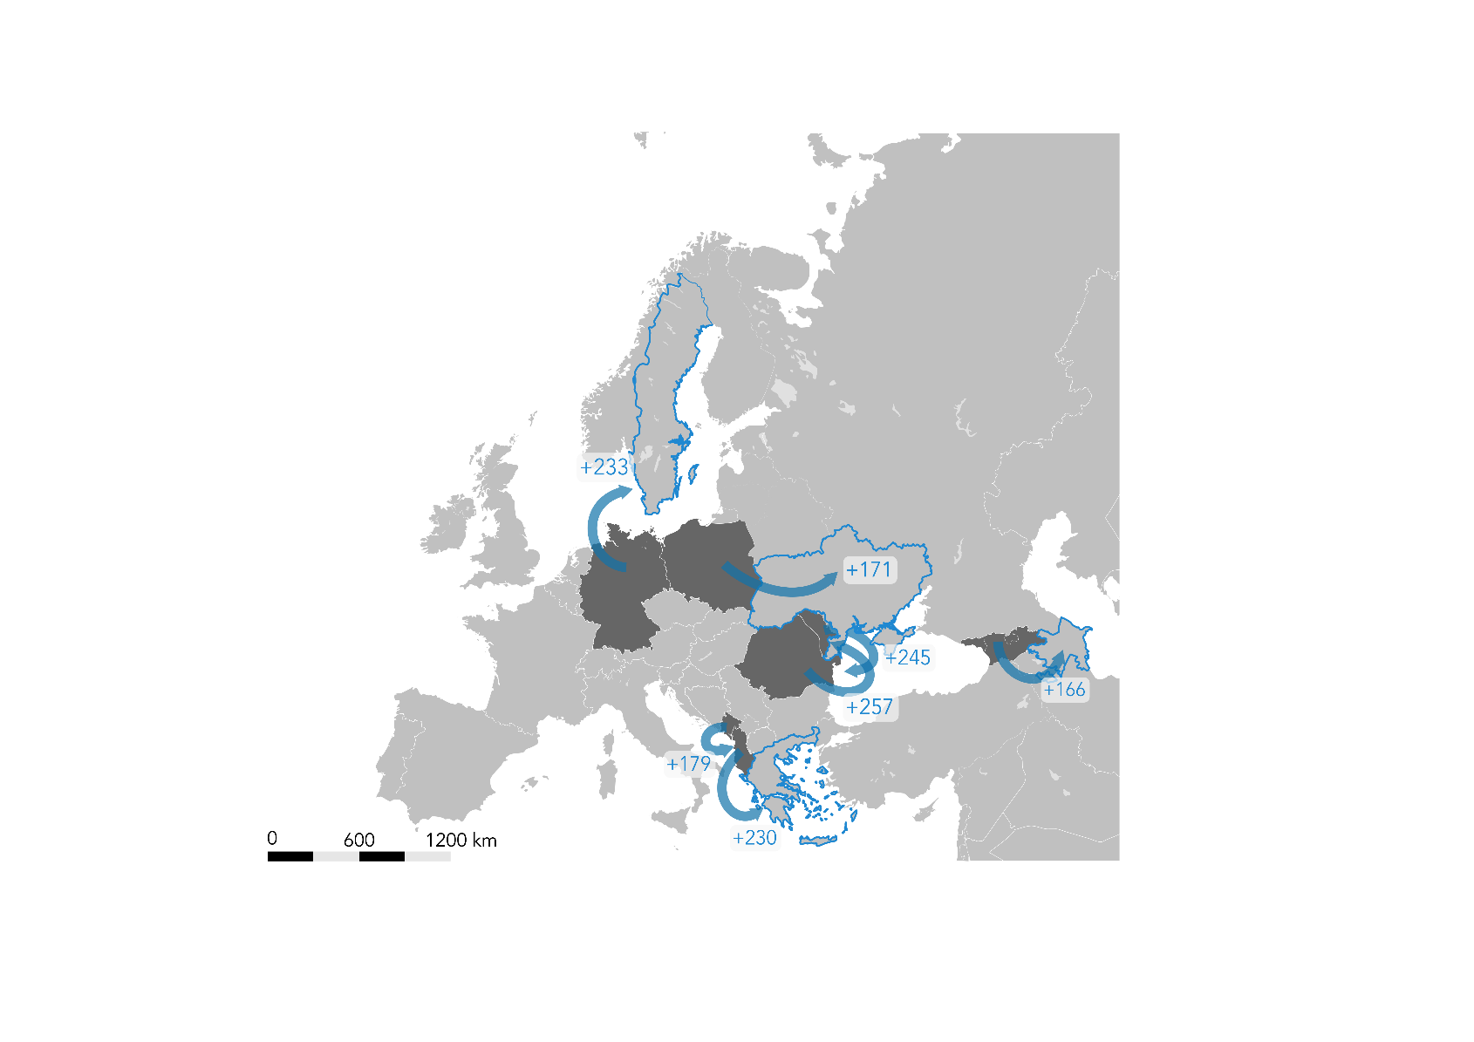
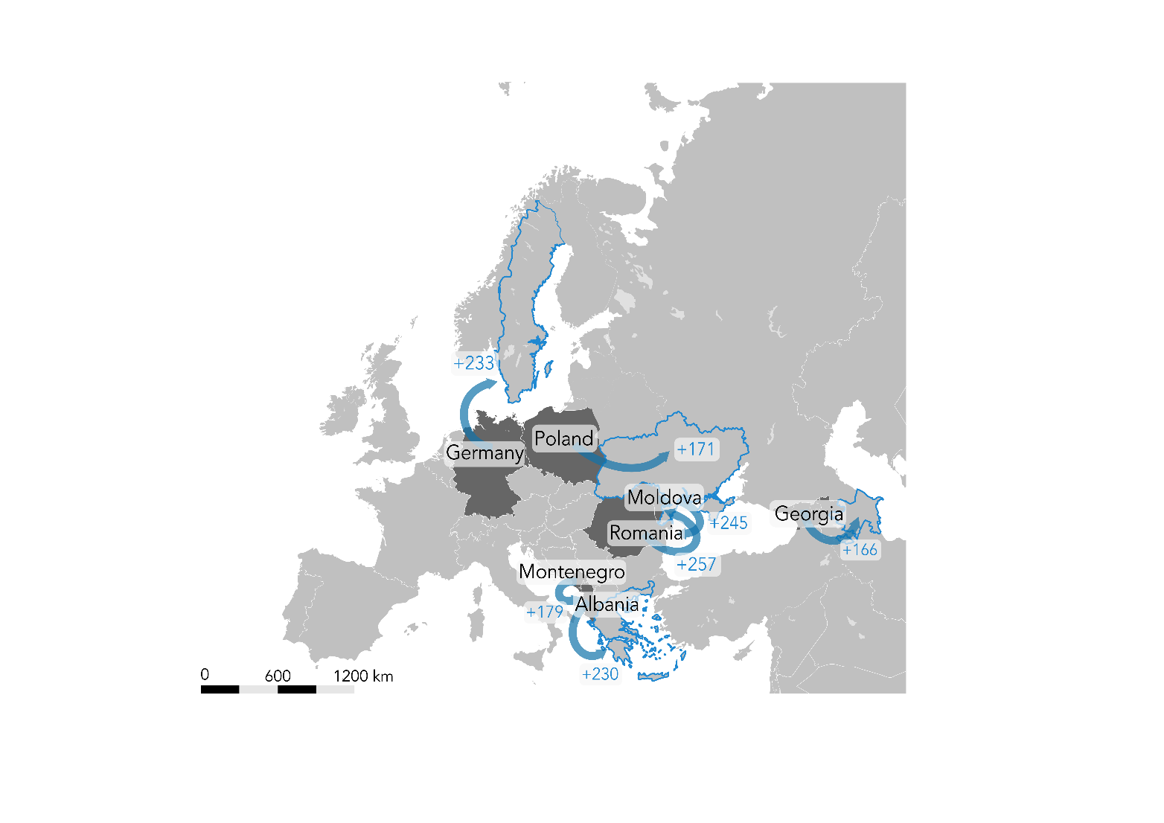

One size does not fit all:
Posters vs. Presentations vs. Publications

Slide 38

This workshop/GitHub is NOT: Designing a poster, presentation, publication…
Illustration from Undraw.co

Slide 39
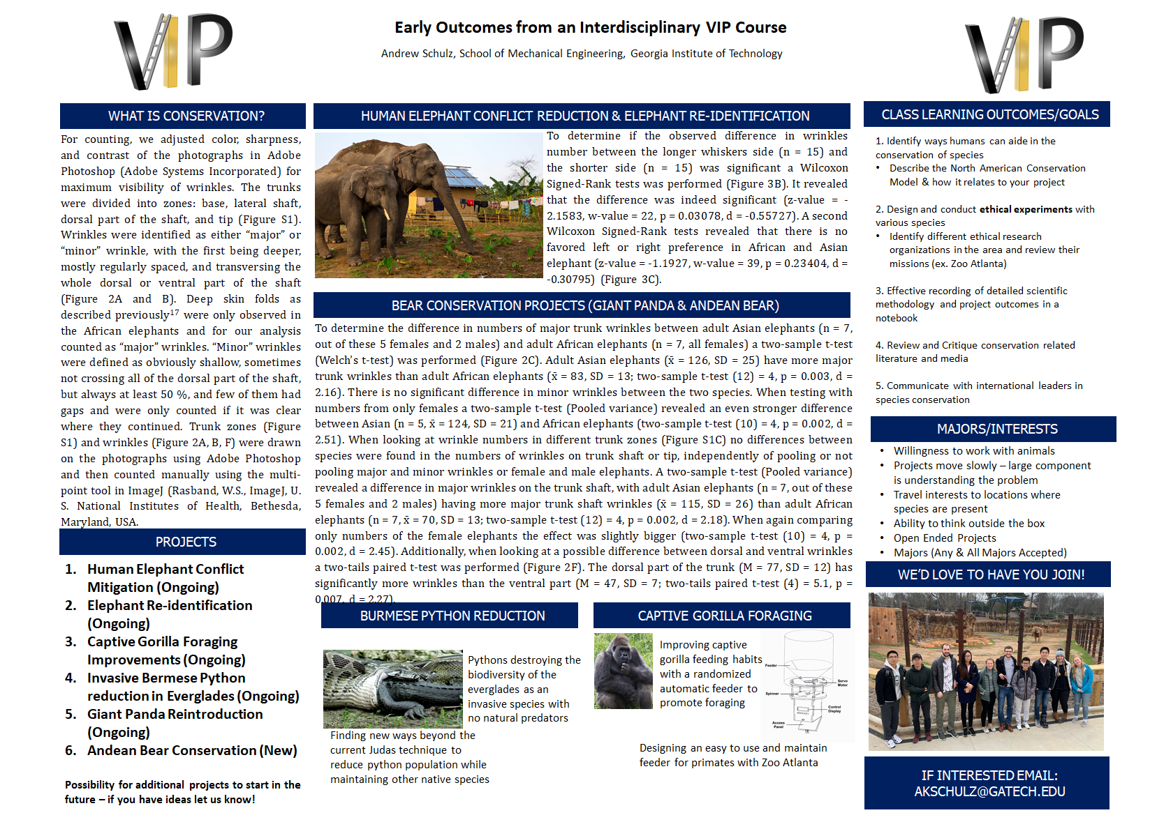
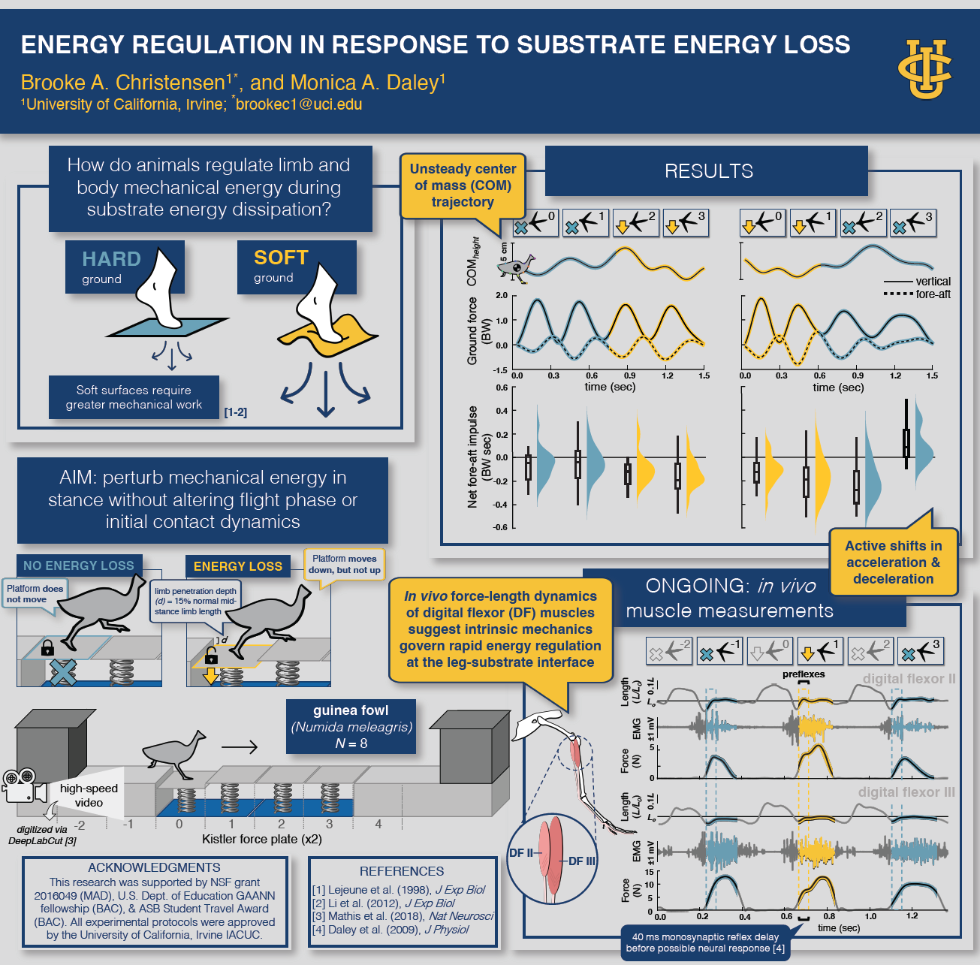
A well designed poster paints a scientific story with or without you
Schulz, A.K. Early Outcomes from an Interdisciplinary VIP Course, Georgia Tech Teachers Appreciation Day 2021
Christensen, B., Daley, M., Energy Regulation in Response to Substrate Energy Loss, American Society of Biomechanics, 2023

Slide 40
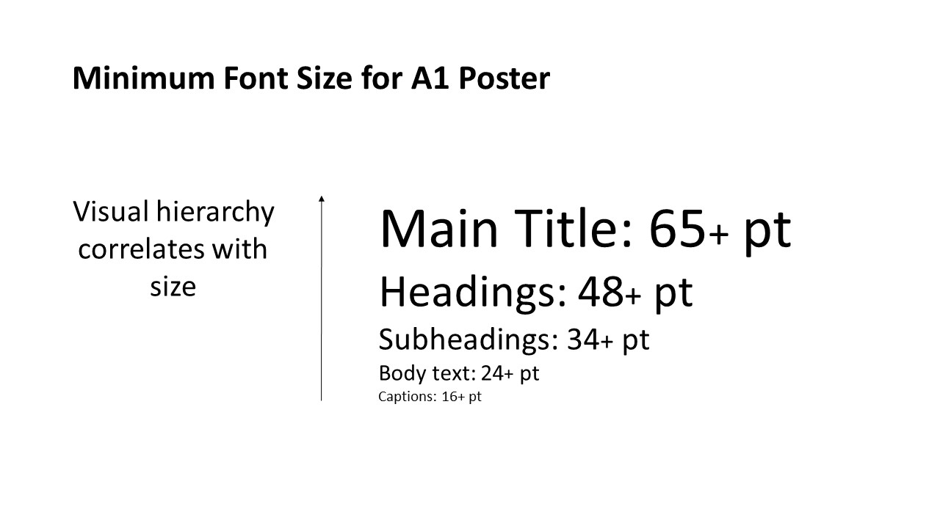
Size matters: when creating posters think aggressively about size

Slide 41
One color scheme: keeping consistent color schemes – logos can be a nice reference
Christensen, B., Daley, M., Energy Regulation in Response to Substrate Energy Loss, American Society of Biomechanics, 2023

Slide 42
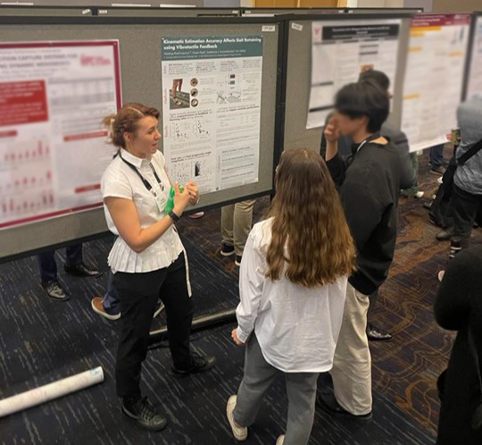
You are not always in front of the poster, provide audience with figure interpretations

Slide 43
Less is more: simplify publication/presentation figs – no animations available

Slide 44

Figure 4 – Poster Variant
Size matters (fonts)
Keep consistent
Less is more
Stands on its own

Slide 45
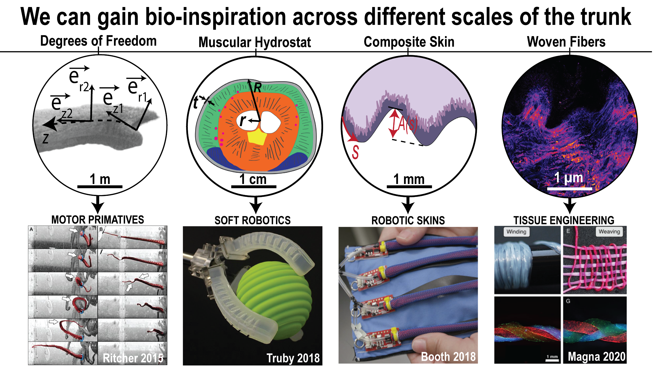
Andrew K. Schulz, Nikole Schneider, Margaret Zhang, Krishma Singal; A Year at the Forefront of Hydrostat Motion. Biol Open 15 August 2023; 12 (8): bio059834.
Notes:
functions

Slide 46
Notes:
functions

Slide 47
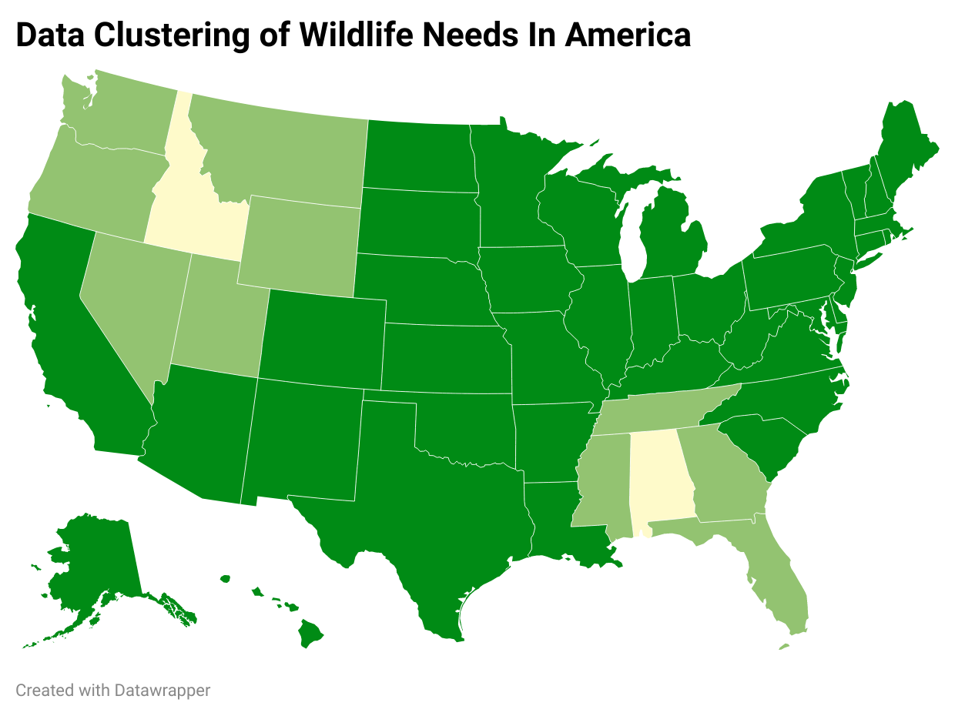
Use the tools at your disposal for a presentation…but don’t overdo it
Visualizations
Animations
Highlighting
Transitions
Schulz AK, et Al. 2023 Conservation tools: the next generation of engineering–biology collaborations. J. R. Soc. Interface20: 20230232.

Slide 48
Notes:
functions

Slide 49
But I have to show all of the data. All of it!?

Slide 50
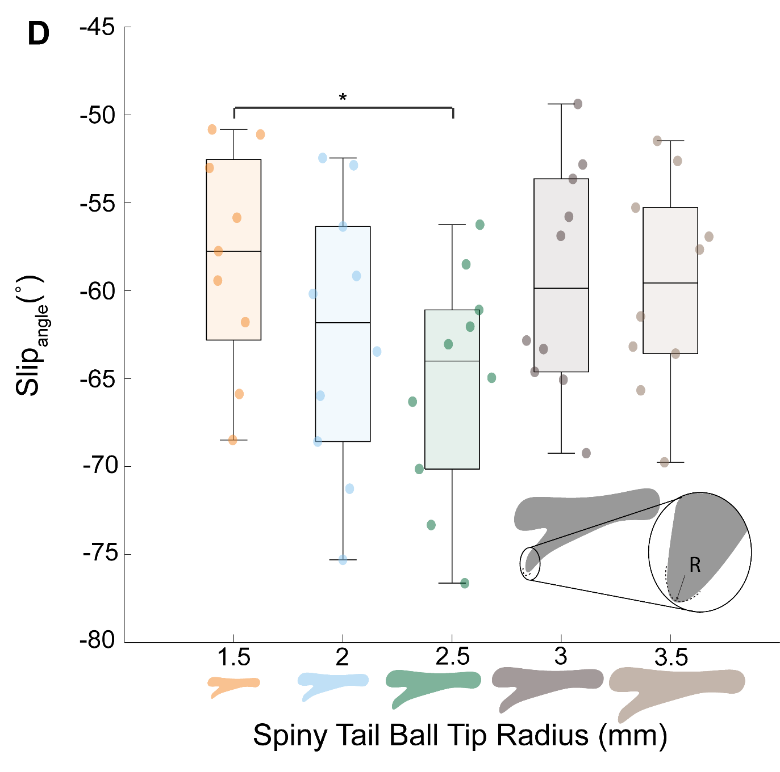
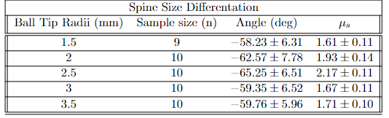
Only a few data points?! Just use a table! NOT
Schulz, A.K., Chellapurath, M., Khandelwal, P., Rezaei, S., Merker, S., Jusufi, A. (2023) Spiny Tail Enhances Traction on Diverse Barks in Pel’s Scaly Tailed Squirrel, In Prep

Slide 51

Figure 4 – Presentation Variant
When making a presentation
Use presentation tools
Modify visuals
The presenter supplements the figures

Slide 52
What are the primary differences you see with posters versus presentations?

Slide 53
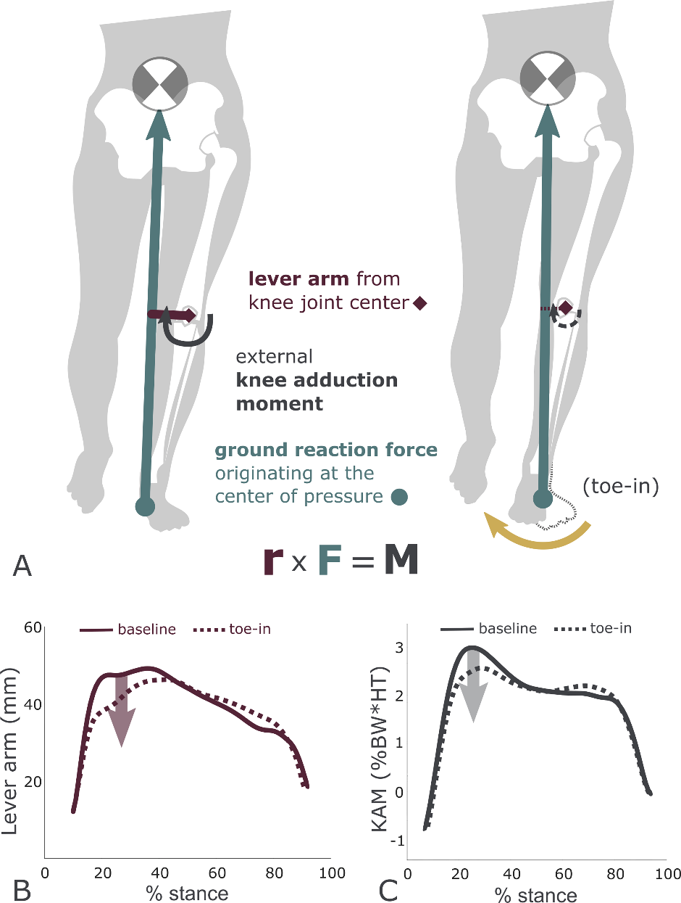
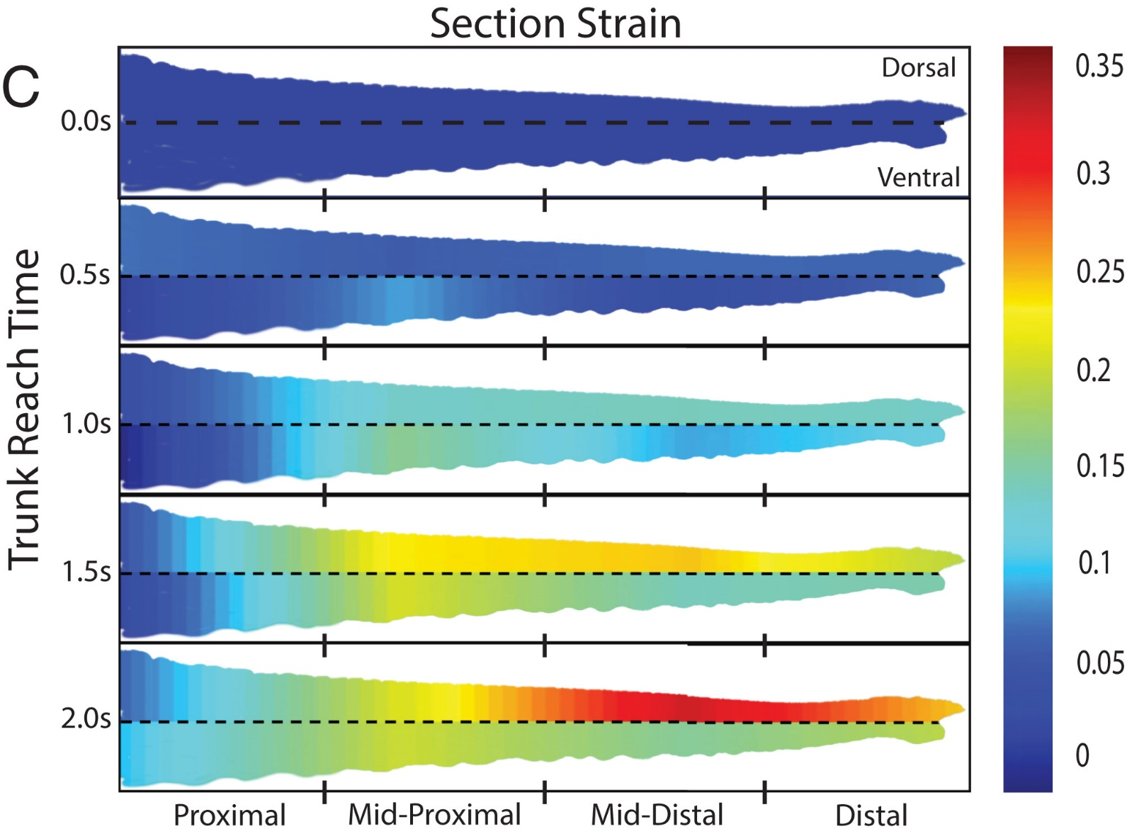
Creating the best currency: visualizations in publications
Rokhmanova N, Kuchenbecker KJ, Shull PB, Ferber R, Halilaj E (2022) Predicting knee adduction moment response to gait retraining with minimal clinical data. PLOS Computational Biology 18(5): e1009500
A. K. Schulz et al., “Skin wrinkles and folds enable asymmetric stretch in the elephant trunk,” Proceedings of the National Academy of Sciences, vol. 119, no. 31, p. e2122563119, Aug. 2022

Slide 54
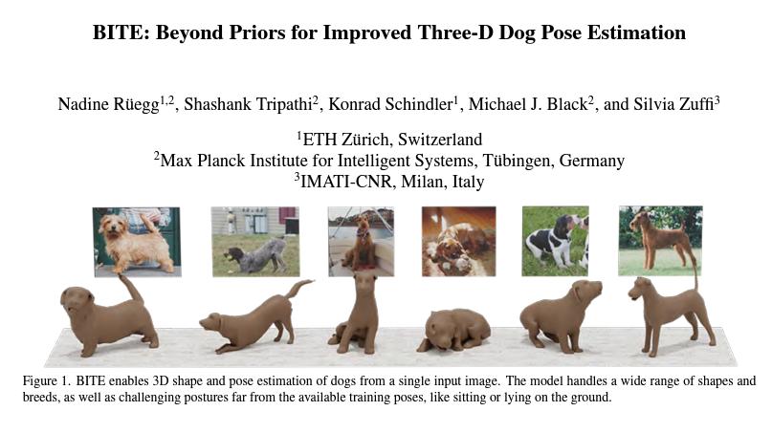
The first figure (the screenshot figure)
Ruegg, N., Tripathi, S., Schindler, K., Black, M., Zuffi, S., BITE: Beyond Priors for Improved Three-D Dog Pose Estimation, IEEE/CVF Conf. on Computer Vision and Pattern Recognition (CVPR), 2023

Slide 55
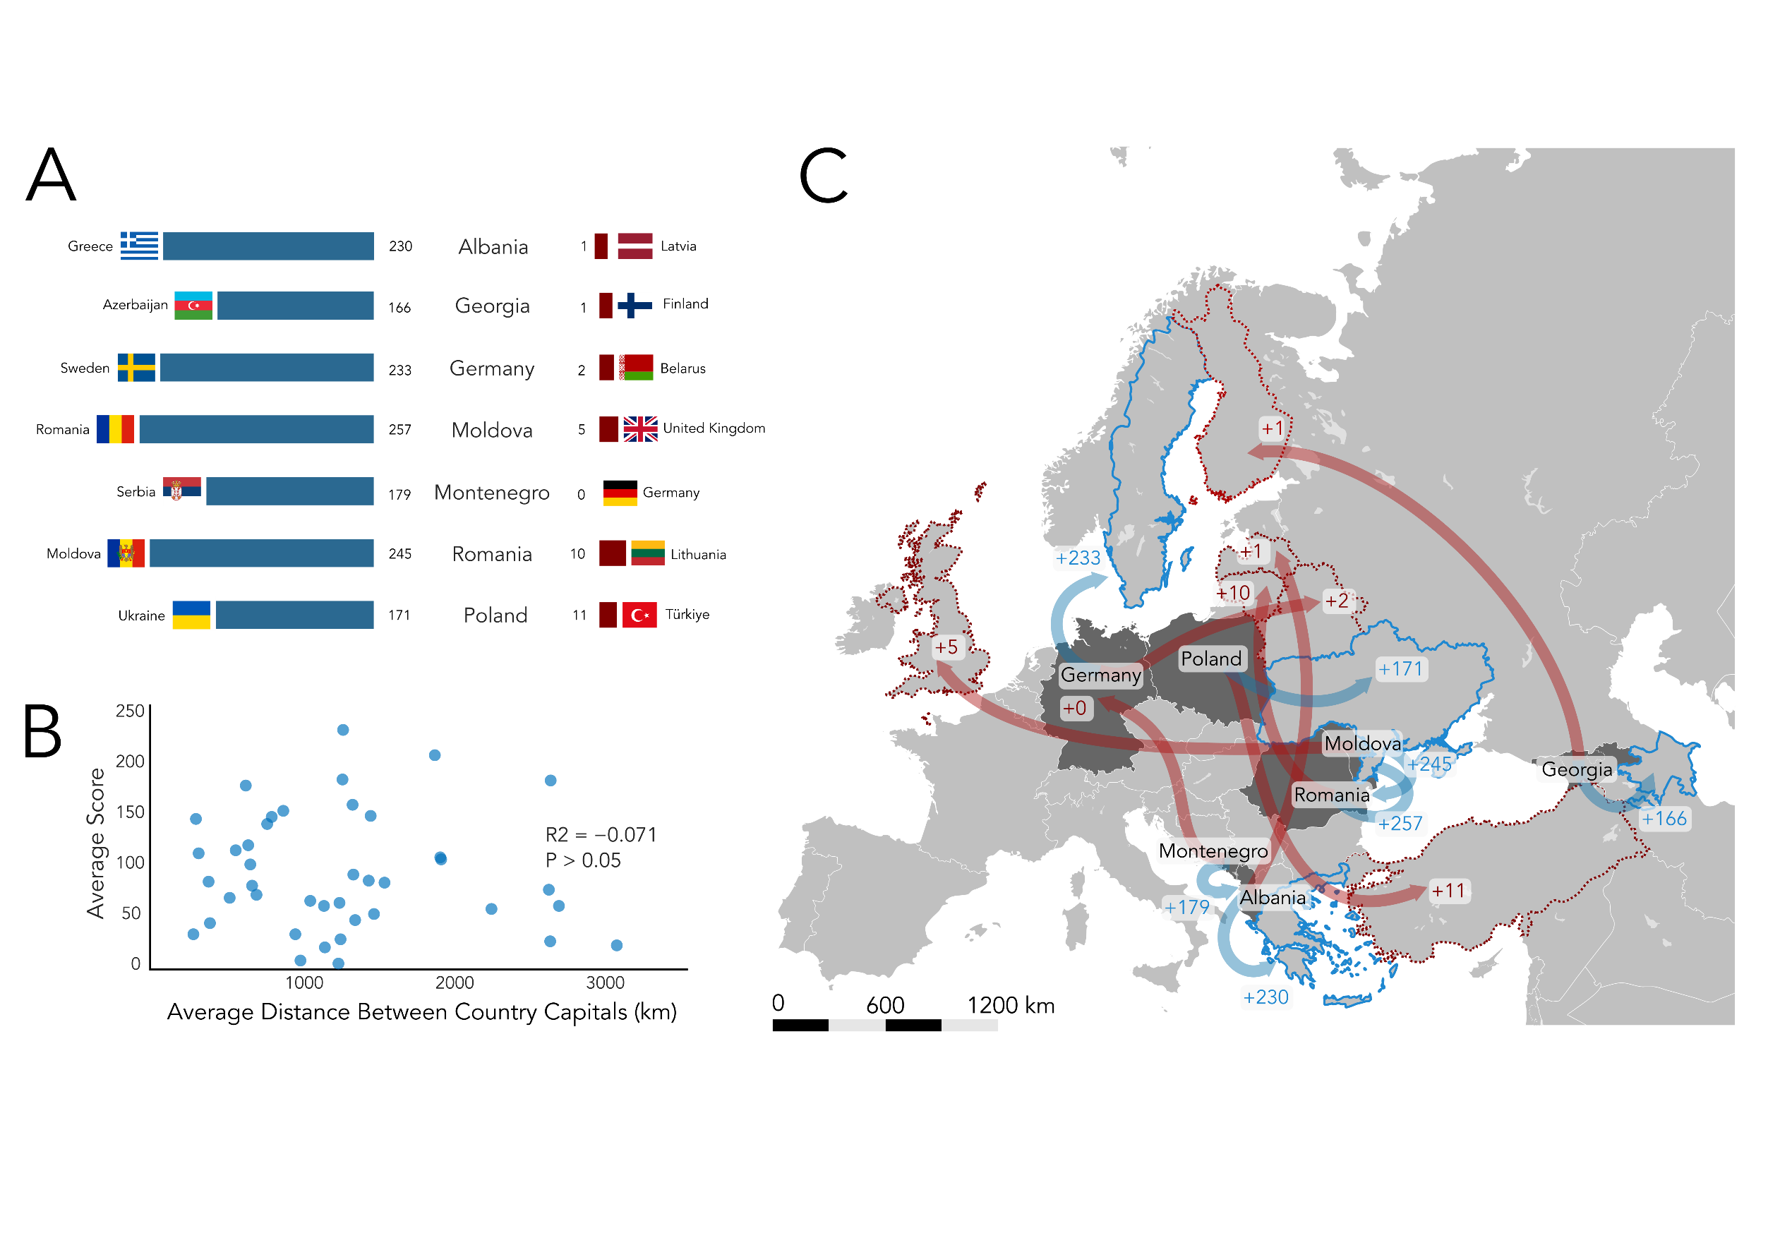
Use your panels

Slide 56
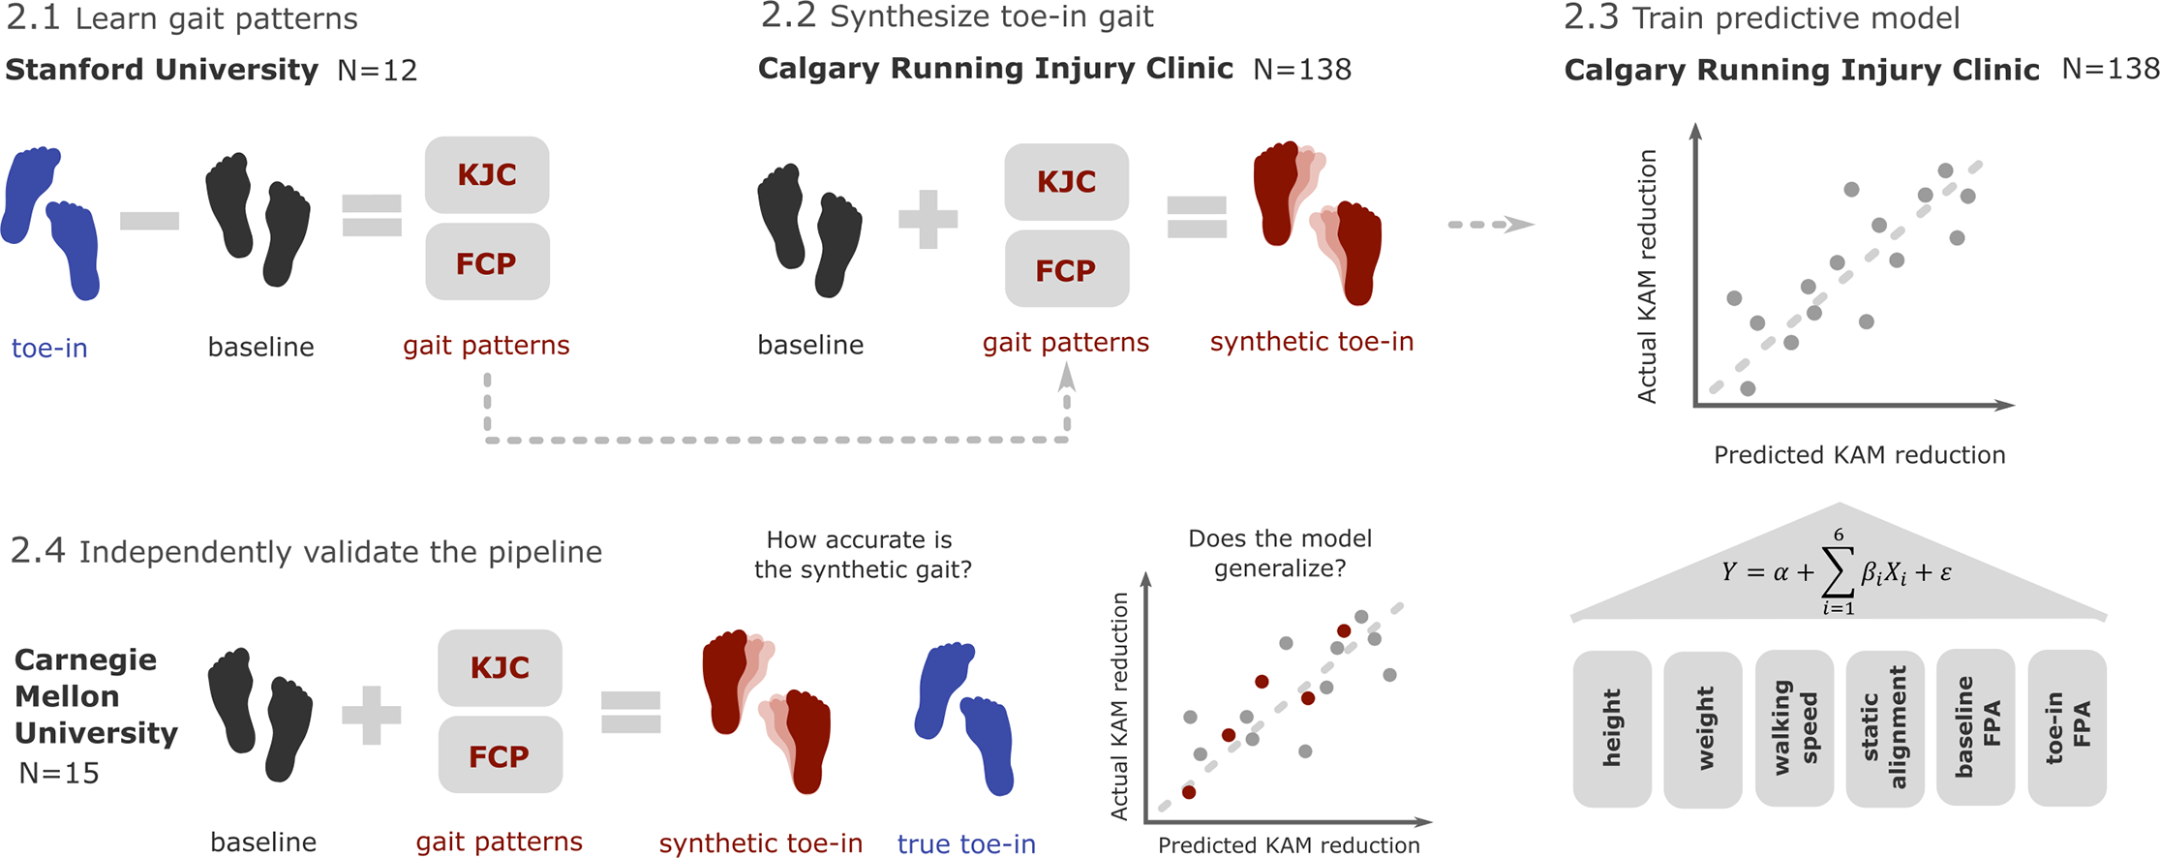
Use schematics to explain findings
Rokhmanova N, Kuchenbecker KJ, Shull PB, Ferber R, Halilaj E (2022) Predicting knee adduction moment response to gait retraining with minimal clinical data. PLOS Computational Biology 18(5): e1009500. https://doi.org/10.1371/journal.pcbi.1009500

Slide 57
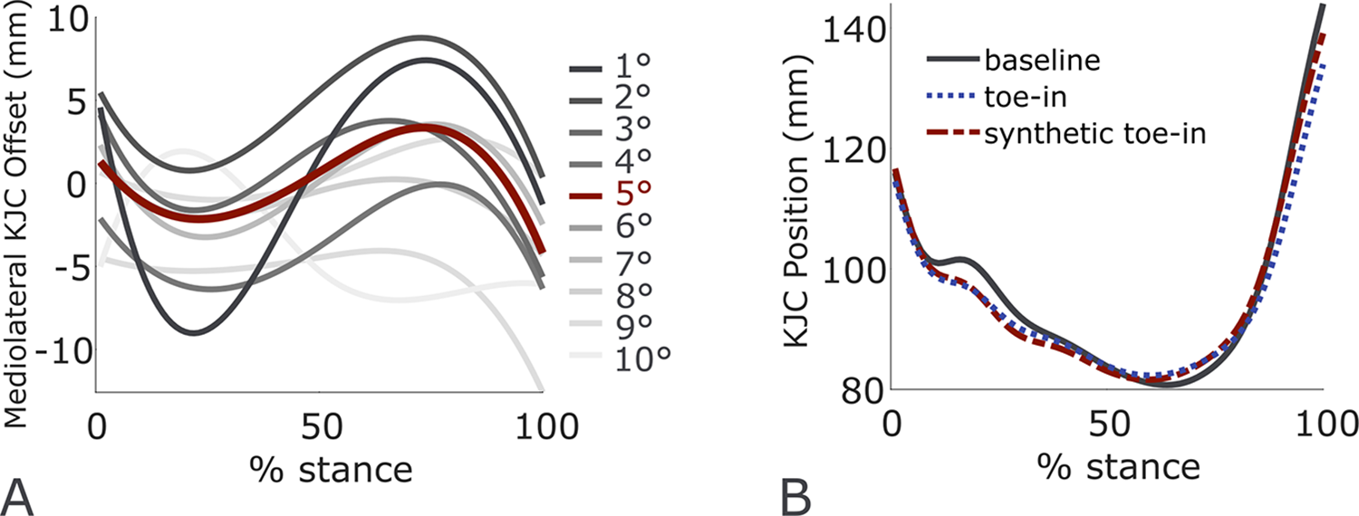
Keep colors consistent for variables
Rokhmanova N, Kuchenbecker KJ, Shull PB, Ferber R, Halilaj E (2022) Predicting knee adduction moment response to gait retraining with minimal clinical data. PLOS Computational Biology 18(5): e1009500. https://doi.org/10.1371/journal.pcbi.1009500

Slide 58

Figure 4 – Publication Variant
When making a presentation
Use schematics
Use panels
Good first impressions
Keep colors consistent

Slide 59
One size does not fit all:
Posters vs. Presentations vs. Publications

Slide 60
Schedule for Today
09:55 – 10:10 - Intro of presenters & purpose of workshop
10:10 – 10:28 - Figure Activity, Spectrum of Figures shown
10:28 – 10:30 - Q&A Break
10:30 – 10:43 - Rubric introduction
10:43 – 10:50 - Q&A Break
10:50 – 11:05 - Posters, presentations, publications, give link sheet out
11:05 – 11:20 - Q&A break & transition to breakouts
11:20 – 11:50 - Breakouts
11:50 – 11:55 - Recap, GitHub discussion
11:55 – 12:00 - LimeSurvey & end

Slide 61
Quick show of hands for the breakout sessions:
1. Inkscape 101
2. Peer review of YOUR figs
You will learn the basics of:
What tools are available to you in Inkscape
How to use (some of) those tools
How to revise a figure we export from MATLAB
(keep your Figure Rubric close at hand)
How to create a vector illustration by using a photo as a guide
You will get to:
Provide and receive feedback on your figures
Try implementing what we learned today
Think more deeply about the best visualization type for your dataset and analysis
Keep and/or update if holding breakout sessions

Slide 62
Recap
TAKE-HOME
LEARNING
Participants will learn how to critically review their figures using:
The Figure Spectrum
The Figure Rubric
Participants will learn about open tools available, such as:
Inkscape
Link Sheet
Participants will understand key differences between:
Figures for publications
… presentations (e.g. TAC meetings)
… and posters

Slide 63

UNIVERSITY HERE
UNIVERSITY HERE
Name Here
Name Here
Title Here
Email Here
Title Here
Email Here
Thanks, y’all!

Slide 64
Bibliography of Figures Used
A. K. Schulz, N. Schneider, M. Zhang, and K. Singal, “A Year at the Forefront of Hydrostat Motion,” Biology Open, vol. 12, no. 8, p. bio059834, Aug. 2023, doi: 10.1242/bio.059834.
N. Ruegg, S. Tripathi, K. Schindler, M. J. Black, and S. Zuffi, “{BITE}: Beyond Priors for Improved Three-{D} Dog Pose Estimation,” presented at the IEEE/CVF Conf.~on Computer Vision and Pattern Recognition (CVPR), 2023.
A. K. Schulz et al., “Conservation tools: the next generation of engineering–biology collaborations,” Journal of The Royal Society Interface, vol. 20, no. 205, p. 20230232, Aug. 2023, doi: 10.1098/rsif.2023.0232.
A. Schulz, “Early Outcomes from an Interdiscplinary VIP Course,” presented at the Georgia Tech Teaching Conference, 2021.
B. Christensen and M. A. Daley, “Energy Regulation in Response to Substrate Energy Loss,” presented at the American Society of Biomechanics, 2023.
N. Rokhmanova, O. Pearl, K. J. Kuchenbecker, and E. Halilaj, “IMU-Based Kinematics Estimation Accuracy Affects Gait Retraining using Vibrotactile Cues,” TNSRE (under review), 2023.
N. Rokhmanova, K. J. Kuchenbecker, P. B. Shull, R. Ferber, and E. Halilaj, “Predicting knee adduction moment response to gait retraining with minimal clinical data,” PLOS Computational Biology, vol. 18, no. 5, p. e1009500, May 2022, doi: 10.1371/journal.pcbi.1009500.
A. K. Schulz et al., “Skin wrinkles and folds enable asymmetric stretch in the elephant trunk,” Proceedings of the National Academy of Sciences, vol. 119, no. 31, p. e2122563119, Aug. 2022, doi: 10.1073/pnas.2122563119.
A. K. Schulz, M. Chellapurath, P. C. Khandelwal, S. Rezaei, S. Merker, and A. Jusufi, “Spiny Tail Enhances Traction on Diverse Barks in Pel’s Scaly Tailed Squirrel,” In Prep, 2023.
K. Gordon, “Using Color to Enhance Your Design,” Nielsen Norman Group. Accessed: Nov. 23, 2023. [Online]. Available: https://www.nngroup.com/articles/color-enhance-design/
*Authors have provided consent to share their figures; all papers included are open-access

Slide 65
Insert a QR Code here if you have a survey for participants
Example question: What could be improved?

